Slide 1

CISP 1020 – Group 2: Chutes and Ladders
By Levi Brown, Bruce Cahilly, Ryan Dunn, Orion Meredith, and Michael Rawiszer

Slide 2

Project Objective
Create a program that emulate the Snake and Ladder game. It is played between two or more players on a gameboard having numbered, gridded squares. Ladders and snakes are pictured on the board, each connecting two specific board squares. The object of the game is to navigate one's game piece, according to dice rolls, from the start (bottom square) to the finish (top square), helped or hindered by ladders and snakes, respectively.

Slide 3

Analysis:
Minimum Requirements –
A means of printing the board
Accepting a variable number of players
Keeping track of each player’s position
Moving each player according to a random dice roll
Readjusting player position if they land on a chute or ladder
Stopping the game once a player wins (reaches end of board)

Slide 4
Analysis:
Extra Features -
Each player's piece is color coded with a unique, random color
Displays an ASCII art version of a dice depending on the number rolled
Allows players to enter their full names which is abbreviated based on the first three letters of the entered name and displayed in the menu
Players can bring up a menu between turns with various commands
Menu allows each player to track their score as well as the spaces affected by a chute or ladder

Slide 5
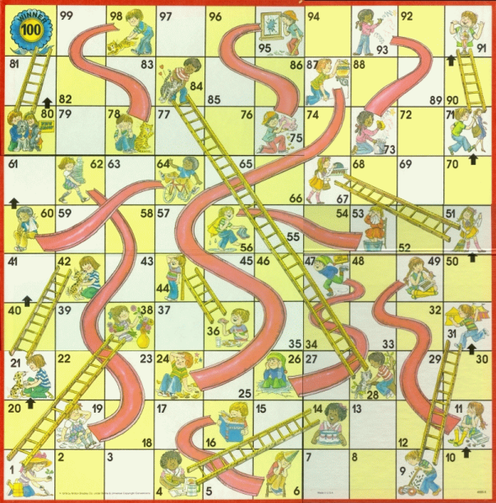
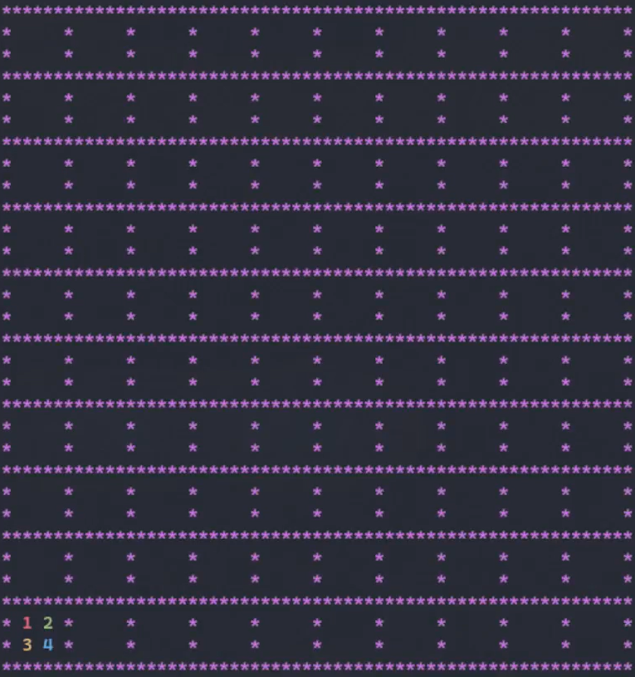
Board Games Comparison:

Slide 6
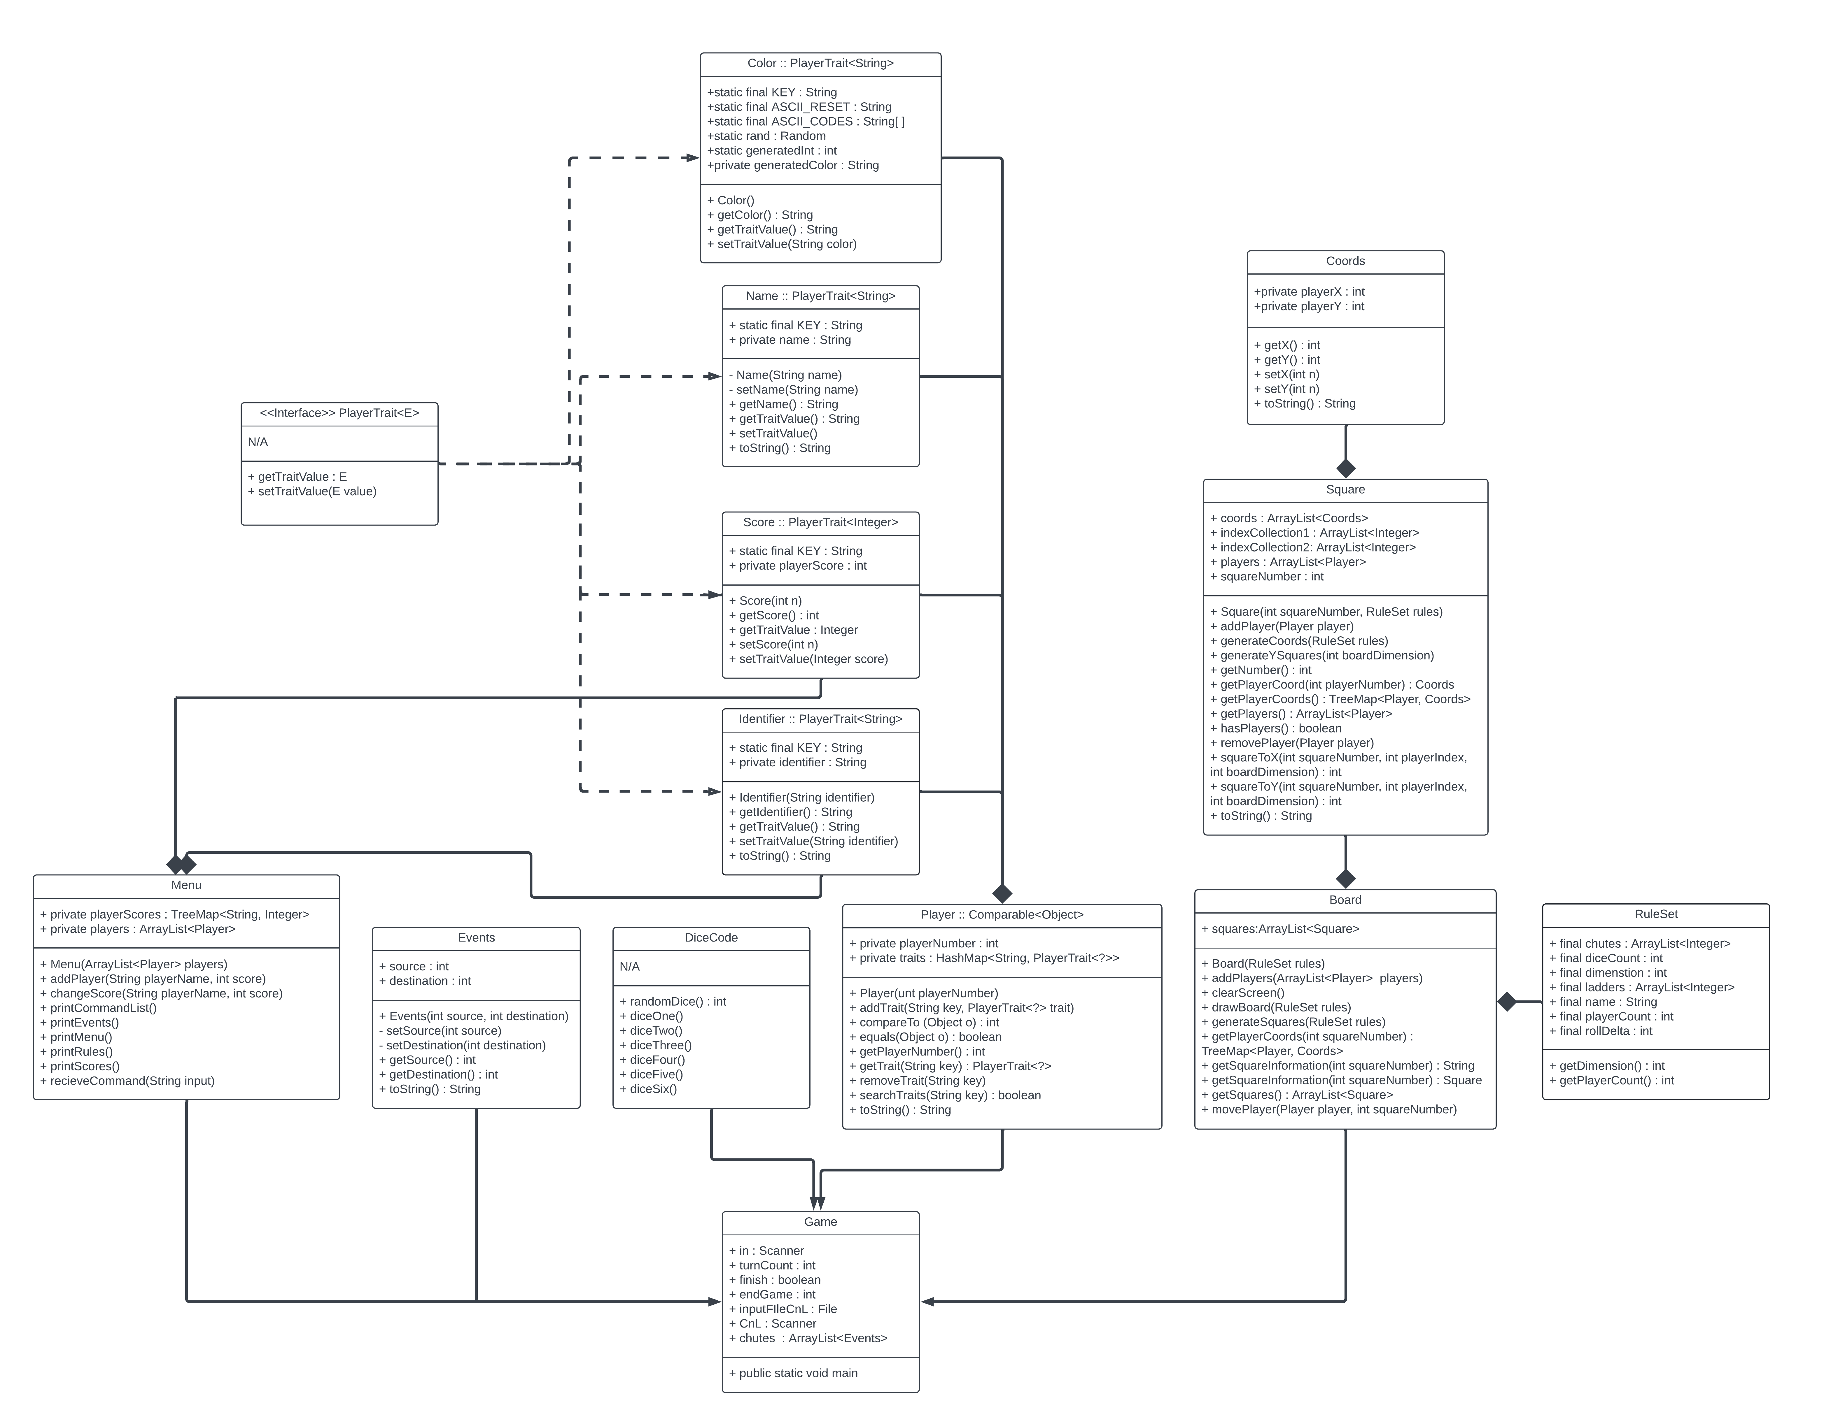
UML Diagram for Project

Slide 7
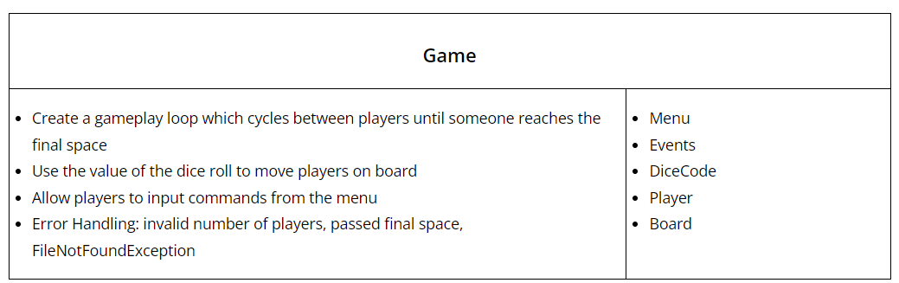
LEVI- Game Main Class CRC CARD
Contains the main game logic
Manages the turns of each player
Uses Dice class to roll a dice every turn
Moves players according to dice rolls
Allows user to request the commands from the Menu
Updates the scores of each player for the Menu class
Handles errors (invalid number of players, passed final space, & FileNotFoundException)

Slide 8
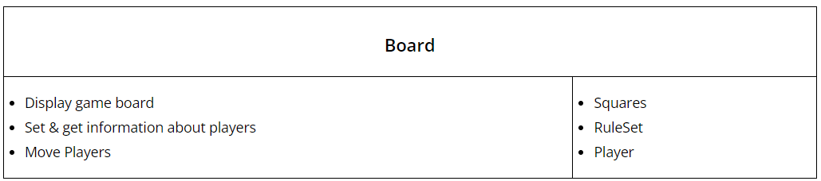
Bruce - Board Class CRC CARD
References information held in external classes to print a recreation of the Chutes and Ladders Game Board.
The methods of this class are called in the main method to produce the Board.
Dependent on Squares, RuleSet, and Player classes for information about the board dimensions / player positions

Slide 9
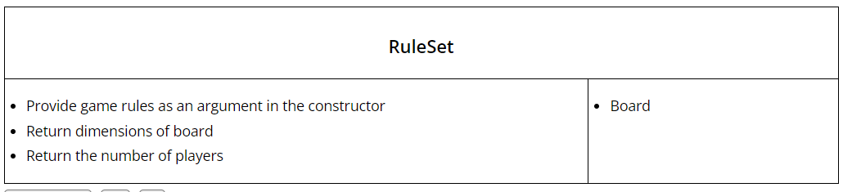
Bruce - ruleset CLASS CRC CARD
Specifies the rules of the game such as the number of players, the size of the board, the number of sides on the dice, and the spaces with a chute or ladder present
Specifies the dimensions, number of players, number of dice rolls per player, the number of sides on the die, and the spaces with chutes & ladders.
Used by the Board class to make the appropriate accommodations for a variable number of players

Slide 10
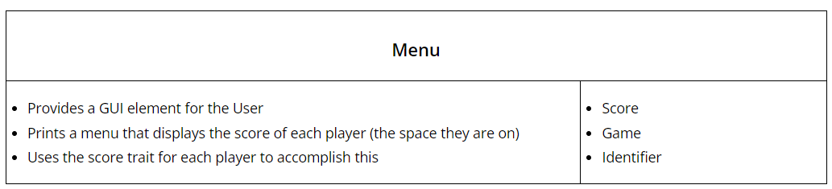
Michael & Ryan – Menu class CRC CARD
Prints the scores of each individual player at the bottom of the board (the space they are on)
Easily readable format for the end-user
Uses the traits of each player (Identifier and Score) to print output
Takes user input from main class to display commands, show the locations of chutes and ladders, or display the scores of each player in a different format

Slide 11
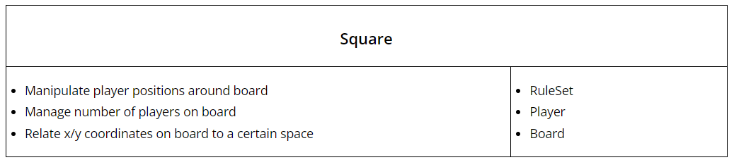
Bruce - SQUARE Class CRC CARD
Optimized version of CISP 1010 Project
Uses an array list of players and coordinates
Keeps track of spaces on the board
Manages number of players
Handles player movement
Checks to see if a player is occupying a certain space

Slide 12
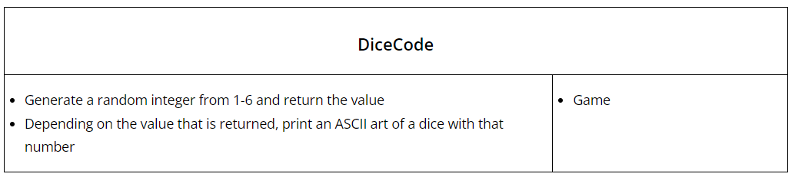
ORION- DICECODE Class CRC CARD
When called, generates a random integer based on the number of sides for a dice
If the number that is generated is a 1, the program displays a dice with the number 1 and so on and so forth
Allows players to easily tell the number of spaces that they moved and makes the game more interactive

Slide 13
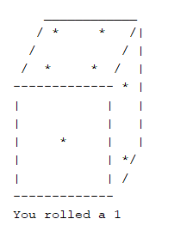
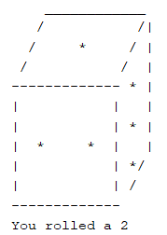
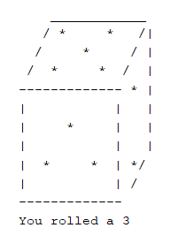
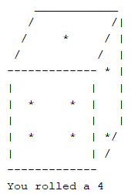
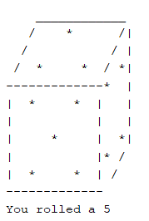
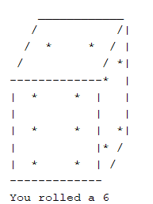
ORION- DICECODE Class

Slide 14
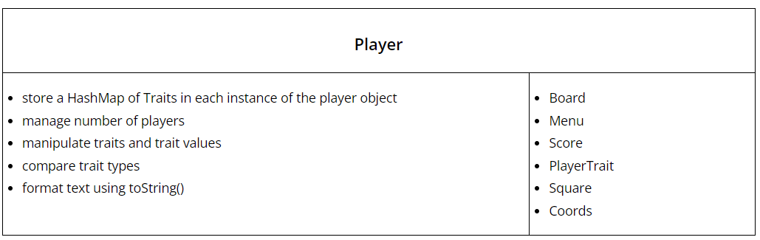
Levi & Bruce – PLAYER CLASS CRC CARD
Stores the traits that are added via the PlayerTrait interface in a HashMap of traits
Manages the traits of each instance of Player (add, remove, & get)
Enables traits and classes to easily cooperate with one another
Implements Comparable (equals and compareTo) in order to see if two traits have the same type or class
Can also output the number associated with the player as well as the HashMap of traits

Slide 15
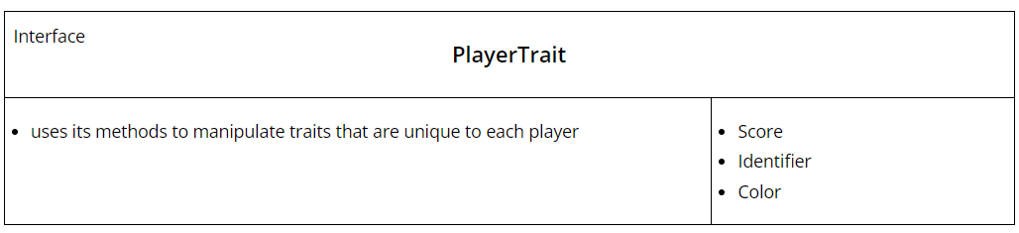
BRUCE - PLAYERTRAIT Interface CRC CARD
Interface allows for arbitrary PlayerTraits via generics
All traits must implement getTraitValue() & setTraitValue()
Traits set a static String KEY to allow uniform access to traits inside of other data structures

Slide 16
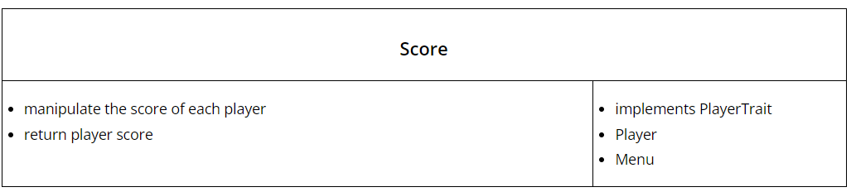
Ryan - score CLASS CRC CARD
Creates Score as a trait that is unique to each player
The score of each player is equal to the space that their token resides on
Manipulates the score trait according to argument passed in the method
Formatted by the Menu class

Slide 17
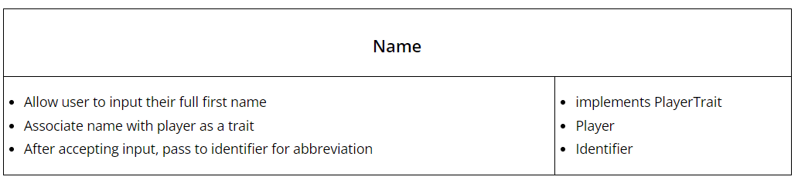
Levi – Name Class CRC CARD
Uses input to store the names of each player
This value is then abbreviated in the Identifier class to allow for any size name to fit within the Menu score display
Easily converts any size name into a 3-character identifier that the player can associate with their piece

Slide 18
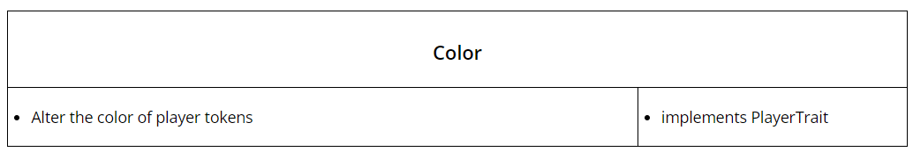
Bruce - COLOR Class CRC CARD
Color codes each player’s token based on a random integer
Colors are selected from an array of ASCII codes that correspond to specific colors
Adds the color of the token as a trait using the PlayerTrait interface
Allows players to easily find their piece on the board

Slide 19
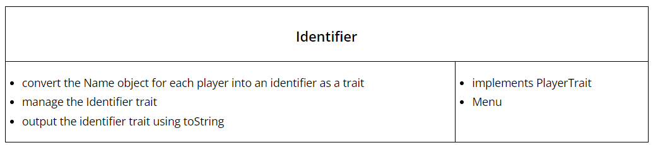
LEVI & Bruce –IDENTIFIER Class CRC CARD
Allows each player to have a string of characters associated with them
The first three letters of the player's name (provided in name class) is set as the identifier
Adds Identifier as a trait of each player
Used in Menu to allow any player's name to fit within the bounds of the menu

Slide 20
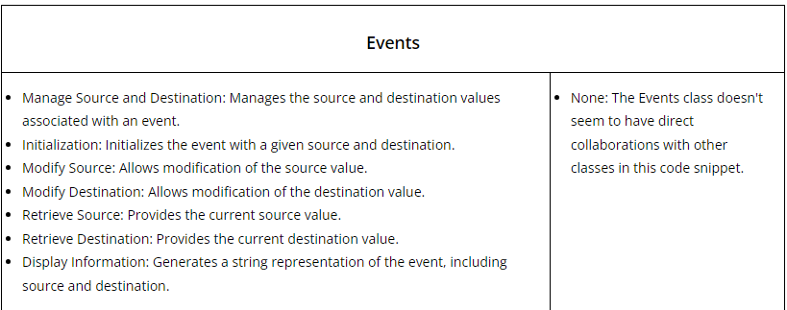
Michael - Events Class CRC CARD
Events refers to a space affected by a chute or ladder
Can retrieve the spaces where any chutes or ladders on the board start as well as where they end up
Enables end-user to use the menu class and enter the commands "-e" to display which spaces are affected by a chute or a ladder

Slide 21
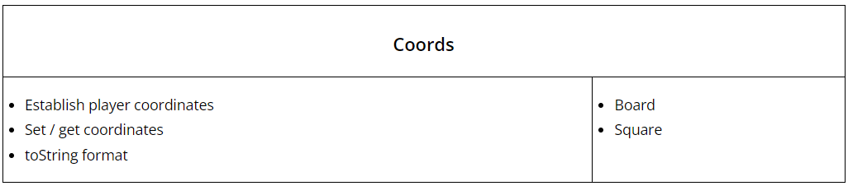
Bruce- COORDS Class CRC CARD
Game board based on an x/y coordinate system in which each character has an x and y value
Manages the coordinates of each player which is then used to determine which space the player is on in Board()
Also uses the toString() method to neatly format the coordinate of the respective plate

Slide 22
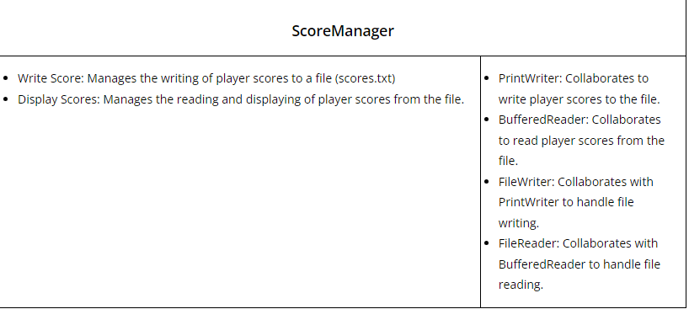
Michael – Score-manager Class CRC CARD
Gets the score of players and their names lists them in a file named “scores.txt”
Also displays the scores of players at the end of the game.

Slide 23
Demonstration
Now that you have seen how the code works, we will provide a demonstration of the program.

